Slide 1
Credit Card Fraud Detection
By
Daniel Timmermann

Slide 2
The Problem:
Credit card fraud continues to be a frequent type of identity theft

Slide 3
The Solution:
Decrease the amount of fraudulent credit card transactions that are not flagged as such

Slide 4
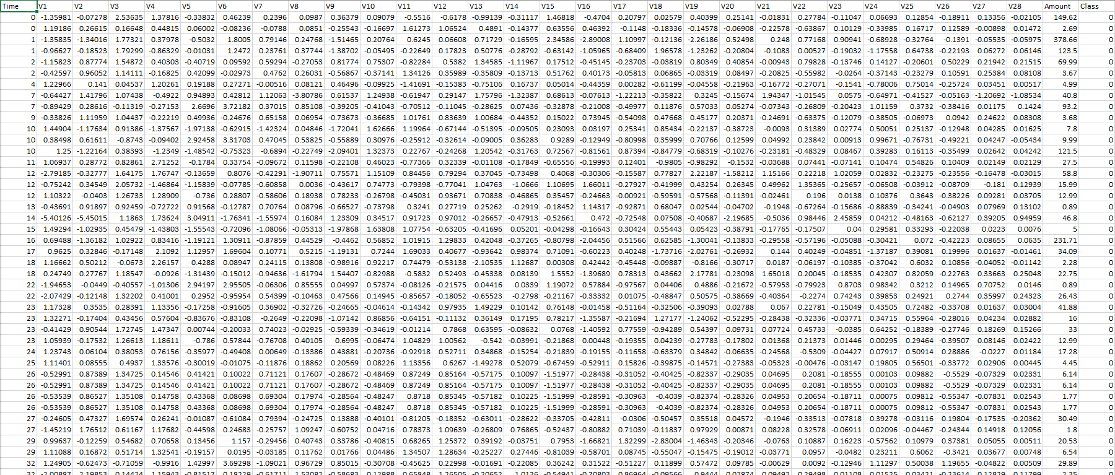
The Data
Data Source : http://www.kaggle.com/mlg-ulb/creditcardfraud

Slide 5
Data Wrangling
Original dataset had ~285,000 rows and 31 columns
Removed 1081 duplicate rows

Slide 6

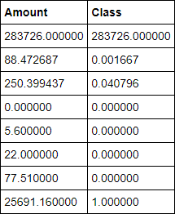
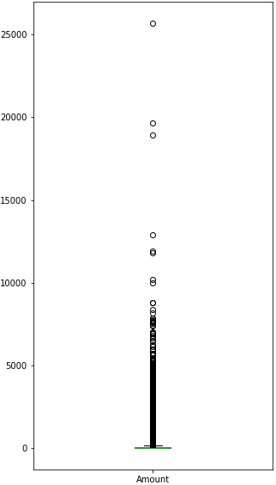
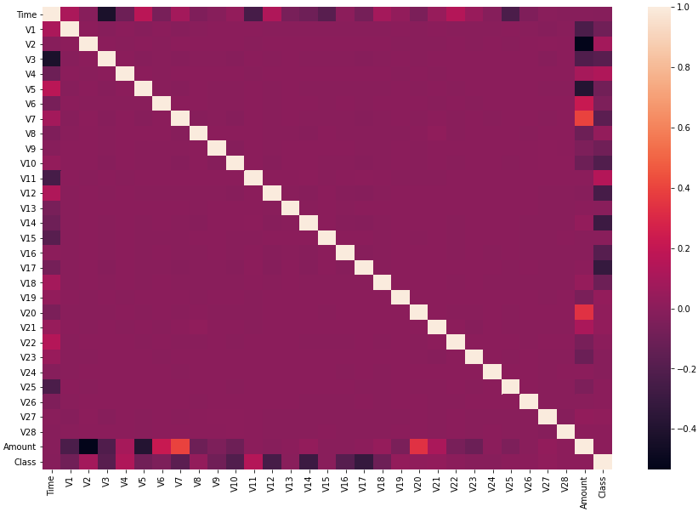
Exploratory Data Analysis

Slide 7
Model Selection
Data Preprocessing
Scaled variables
283,253 non fraudulent and 473 fraudulent (highly imbalanced)
After random undersampling there are 473 non fraudulent and 473 fraudulent
Collected 5 samples
Logistic Regression
Random Forest
Support Vector Machine

Slide 8
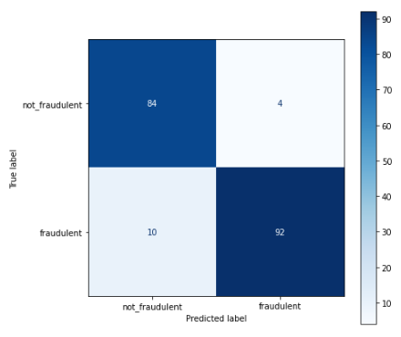
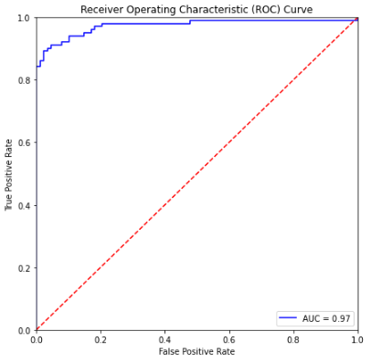
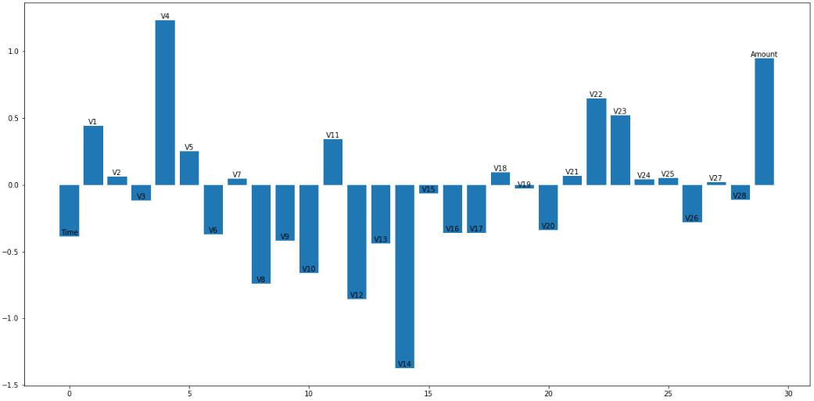
Logistic Regression

Slide 9
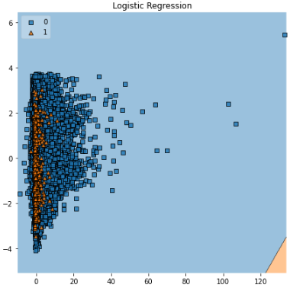
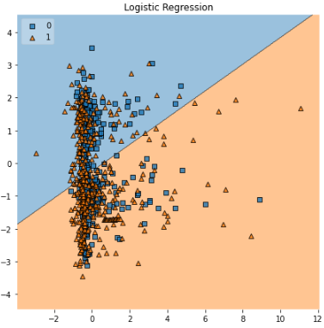
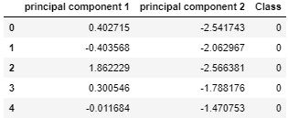
Decision Boundary

Slide 10
Takeaways
Logistic Regression was the best model
19 features are not important
Different samples generate different results

Slide 11
Future Research
Use different sampling methods
Random Oversampling
Synthetic Minority Oversampling Technique (SMOTE)
Re-train model with the more important features
Hyperparameter tuning for logistic regression

Slide 12
Questions?

